Slide 1

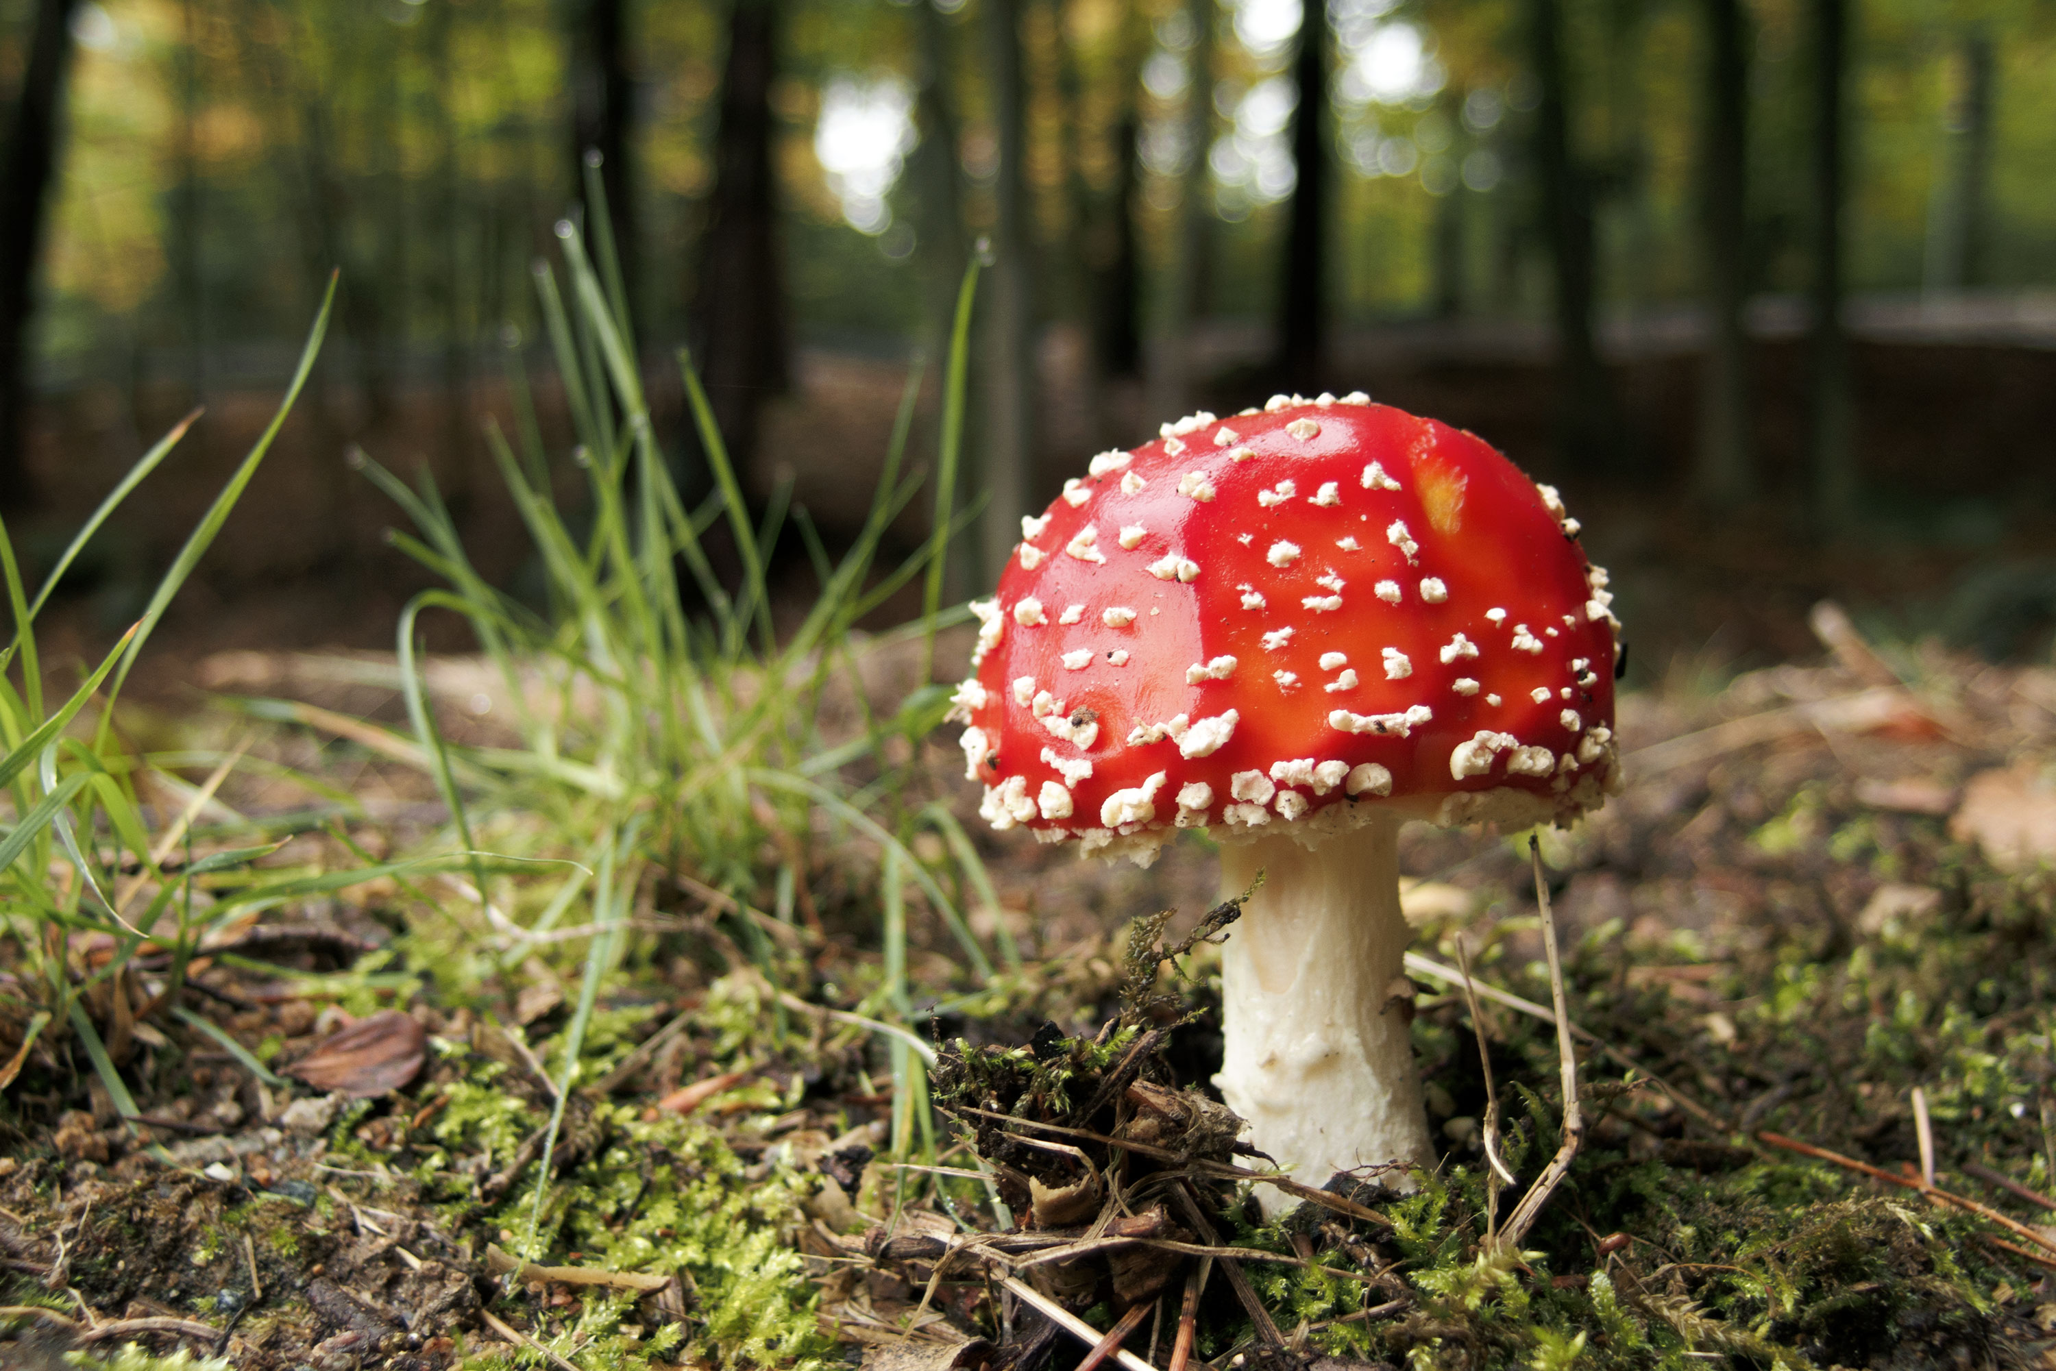
IML PROJECT MUSHROOM CLASSIFICATION

Slide 2

GROUP MEMBERS
Brundha Devi. A (B23CH1015 )
Aakarshana A (B23ME1002)
Vallimpula Niveditha (B23MT1044)
Yashaswini Tirupathi (B23CI1039)

Slide 3
Project analysis slide 2
Project Analysis
K-Nearest Neighbors (KNN)
A non-parametric algorithm that classifies data points based on the majority label among their 'k' nearest neighbors.
Decision Trees
A tree-structured model that splits data into subsets based on feature values, aiming to maximize information gain at each split.
Methods used in this project
Logistic Regression
A statistical model that predicts the probability of a binary outcome using a logistic function based on linear combinations of input features.
Support Vector Machine (SVM)
A supervised learning model that finds the optimal hyperplane to separate classes by maximizing the margin between them.

Slide 4
Project analysis slide 8
Overview of Original Data
K-Nearest Neighbors (KNN)
Logistic Regression
Decision Trees
Support Vector Machine (SVM)
The KNN model achieved an accuracy of 99.917% on the test set. This high accuracy indicates that the model is effective at classifying the data correctly in most cases.
The logistic regression model shows robust performance even in the presence of outliers, with an accuracy of 94.67%. The KNN model further corroborates these results, suggesting a reliable classification framework for the mushroom dataset
The Decision Tree Classifier using the Gini index criterion performed effectively in classifying mushrooms, achieving competitive accuracy on both the training (95.74%) and test sets (96.14%).
The SVM model demonstrated exceptional effectiveness with a accuracy of 99.01% - with kernel linear,100% with kernel poly ,100% with kernel rbf.

Slide 5

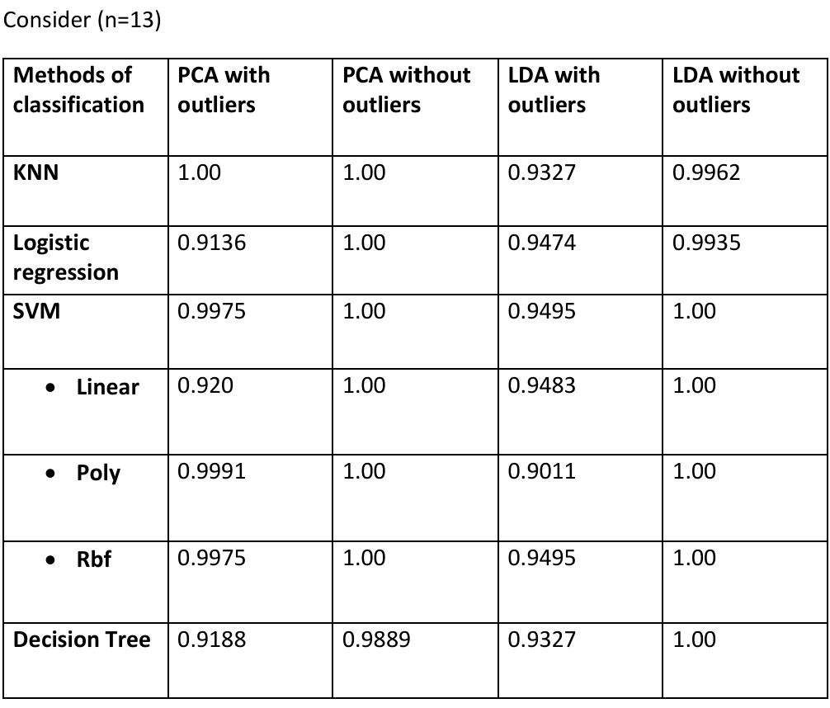
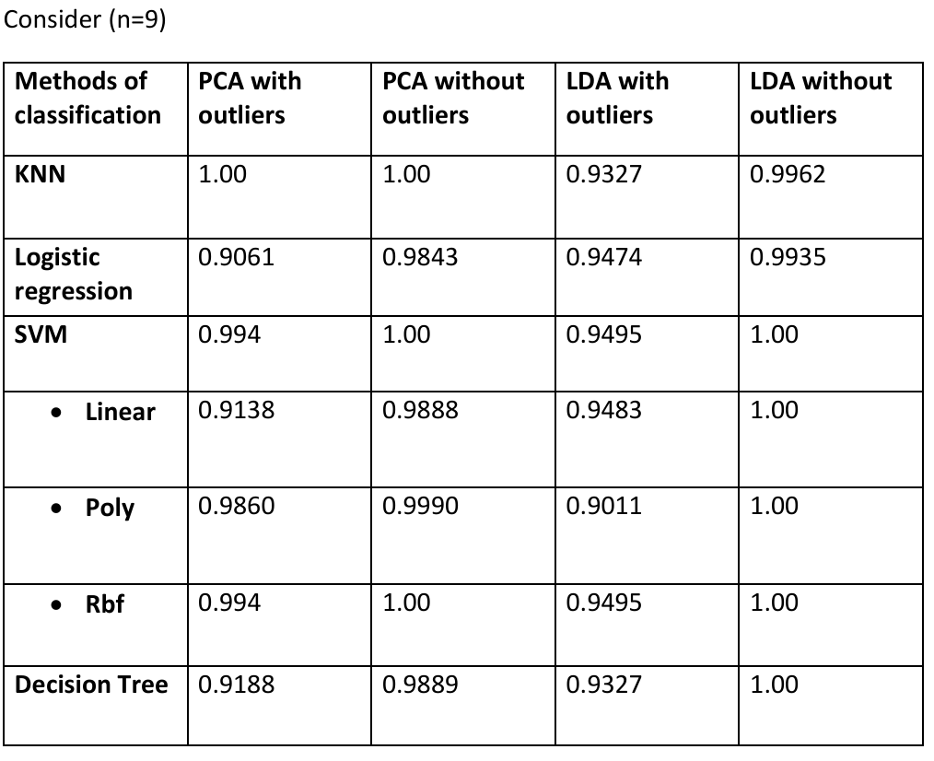
Project analysis slide 11
Comparison
Classification Accuracies Across Different Methods

Slide 6
Project analysis slide 8
CONCLUSION
PCA (Principal Component Analysis)
LDA (Linear Discriminant Analysis)
KNN achieved perfect accuracy (1.00), showing robustness to outliers.
Logistic Regression and Decision Tree showed moderate performance (0.9136 and 0.9188, respectively), indicating some sensitivity to outliers.
SVM performed well (0.9975), especially in RBF kernel.
KNN and SVM maintained high accuracy (0.9327 and 0.9495, respectively).
Logistic Regression also performed moderately (0.9474).
Decision Tree showed lower accuracy (0.9327), indicating sensitivity to outliers.
With Outliers
All models showed improved accuracy. KNN and SVM achieved perfect accuracy (1.00) across all kernels.
Logistic Regression and Decision Tree also saw increased performance (0.9843 and 0.9889, respectively).
All models improved significantly with outlier removal.
KNN, SVM (across all kernels), and Decision Tree achieved perfect accuracy (1.00)
Without Outliers

Slide 7

Final selected model
KNN and SVM (RBF kernel) are the best choices for the mushroom classification task, as they consistently achieved the highest accuracy across different dimensionality reductions techniques and outlier scenarios.

Slide 8
Thank You

